Slide 1
Software Engineering (SE)
By Sandia Kumari

Slide 2
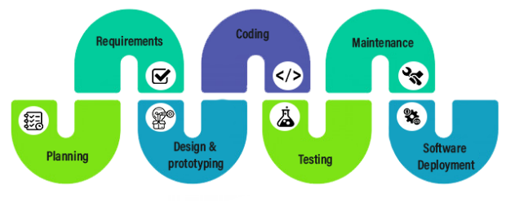
Software Development Lifecycle
New Chapter

Slide 3
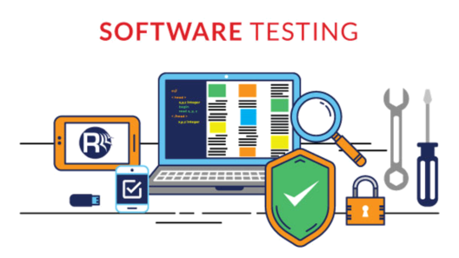
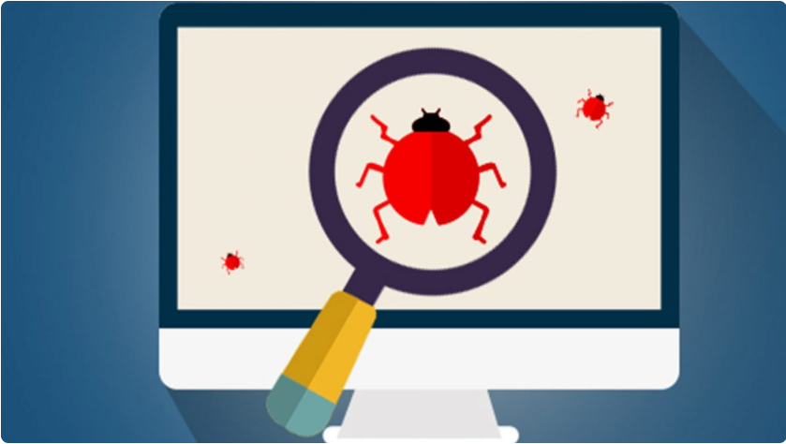
About Today’s Lecture
New Chapter

Slide 4
Objectives
understand the stages of testing from testing during development to acceptance testing by system customers;
have been introduced to techniques that help you choose test cases that are geared to discovering program defects;
understand test-first development, where you design tests before writing code and run these tests automatically;
know about three distinct types of testing—component testing, system testing, and release testing;
understand the distinctions between development testing and user testing.

Slide 5





Why do we test?

Slide 6
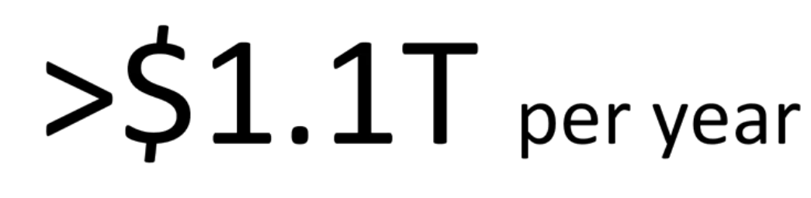
Cost of Software Failures in 2016

Slide 7
So software now is important to our finances, it's important to our infrastructure, and it's important to our lives.
And we rely on software testing to help us get it right.

Slide 8
Testing
The process of executing a program (or part of a program) with the intention of finding errors (Myers via Humphrey)
The purpose of testing is to find errors
Testing is the process of trying to discover every conceivable fault or weakness in a work product (Myers, via Kit)
The process of searching for errors (Kaner)
Testing is intended to show that a program does what it is intended to do and to discover program defects before it is put into use.

Slide 9
Validation Testing v/s Defect Testing
Demonstrate to the developer and the customer that the software meets its requirements. For custom software, this means that there should be at least one test for every requirement in the requirements document. For generic software products, it means that there should be tests for all of the system features that will be included in the product release. You may also test combinations of features to check for unwanted interactions between them.
2. Find inputs or input sequences where the behavior of the software is incorrect, undesirable, or does not conform to its specification. These are caused by defects (bugs) in the software. When you test software to find defects, you are trying to root out undesirable system behavior such as system crashes, unwanted interactions with other systems, incorrect computations, and data corruption

Slide 10
Defect testing:
Tests designed to discover system defects
A successful defect test is one which reveals the presence of defects in a system .
Validation testing:
Intended to show that the software meets its requirements
A successful test is one that shows that a requirement has been properly implemented

Slide 11
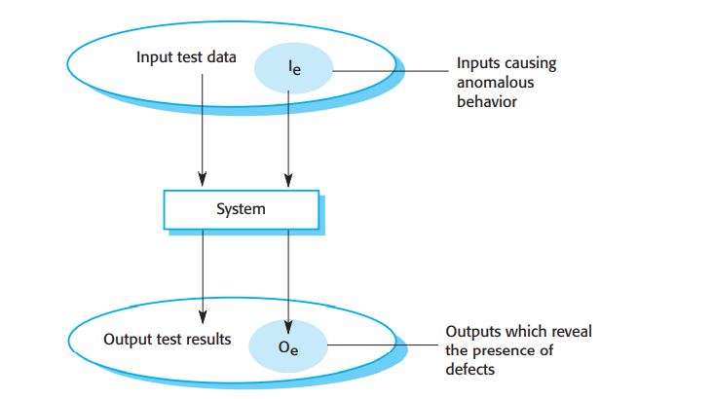

Slide 12
What is a Test?
Correct result?
Output
Test data
Software under Test
Oracle

Slide 13
What is a Test?
Test Cases
Expected
Output
Test data
Output
Software under Test
Oracle
Notes:
Oracle is tester

Slide 14
Test data and Test cases
Test data
Inputs which have been devised to test a system
Test Cases
Inputs to the system and the predicted outputs from operating the system on these inputs, if the system performs to its specification

Slide 15
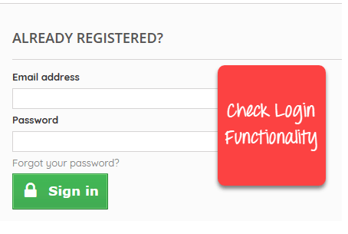
How to Write Test Cases in Manual Testing
Let’s create a Test Case for the scenario: Check Login Functionality

Slide 16
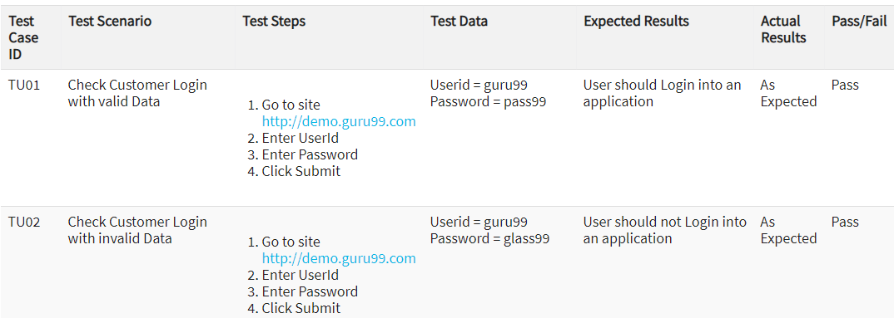

Slide 17
What is a bug?
Fault : The fault is a defect in the system that can cause an error.
Error : Refers to difference between Actual Output and Expected output.
Failure : It is the inability of a system or component to perform required function according to its specification.

Slide 18
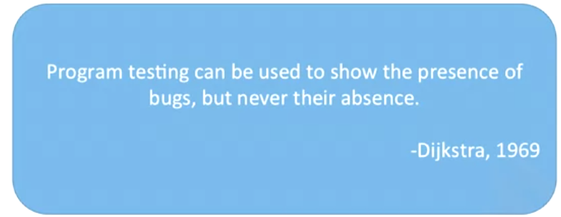
Axiom of testing

Slide 19
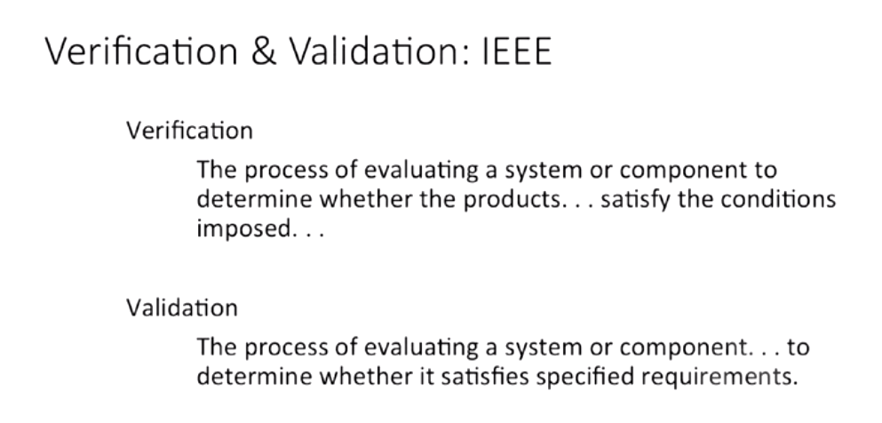

Slide 20
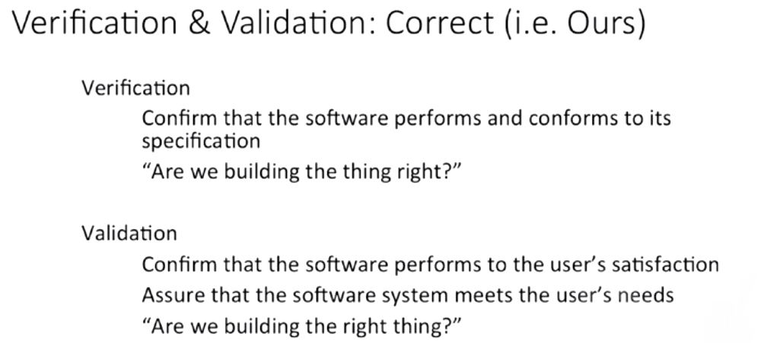
The software should do what the user really requires.

Slide 21
Verification and Validation
Software verification is the process of checking that the software meets its stated functional and non-functional requirements.
The aim of software validation is to ensure that the software meets the customer’s expectations. It goes beyond checking conformance with the specification to demonstrating that the software does what the customer expects it to do.

